Slide 1
Group 3 28-11-2018 DVA313
Erika Weilander
Christoffer Parkkila
Filip Andersson
Matko Butkovic
Zaid Abed Jaser
Osamah Al-Braichi
Mohammed Abusamaan
Sai Vijay Vemasani

Slide 2
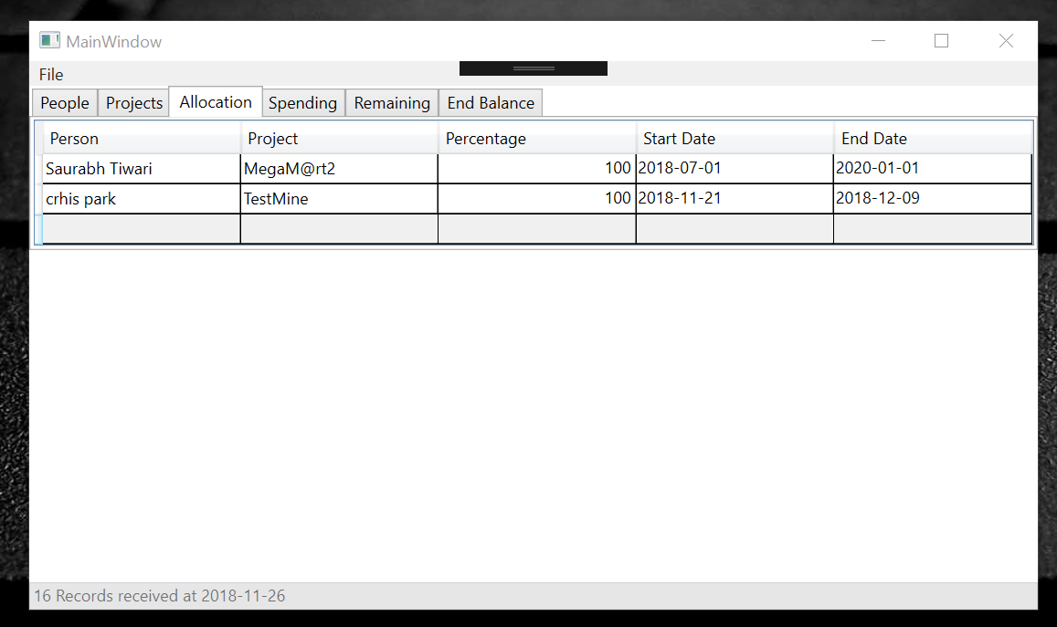
Initial application

Slide 3
Project scope
Goal is to refactor and enhance the existing application to more user-friendly and improve/implement GUI
Web application provides functionalities:
managing projects,
allocation of university employees and
control of spending
Set an individual duration of time on a project but also set how much percentage of their time one person is allowed to spend on the project

Slide 4
Client and interaction
Client is a representative of university and person who would be using the web application
Meetings with the client on every Monday
Collecting client stories and extracting system requirements
Presenting the client possible solutions
Additional requirements
High level ideas –> ID, Client story, Requirement/s, Priority, Duration, Effort, Persons (repetitive process)
Project scope is clear
Priority - features are ordered according:
most relevant (important) functionalities that our project must contain and
additional features which can/should be implemented (additional objectives)

Slide 5

What is in the initial backlog?
Notes:
I’m going to go over all the user requirements we have elicited so far, and briefly elaborate on those to give you a little more insight in our project.

Slide 6
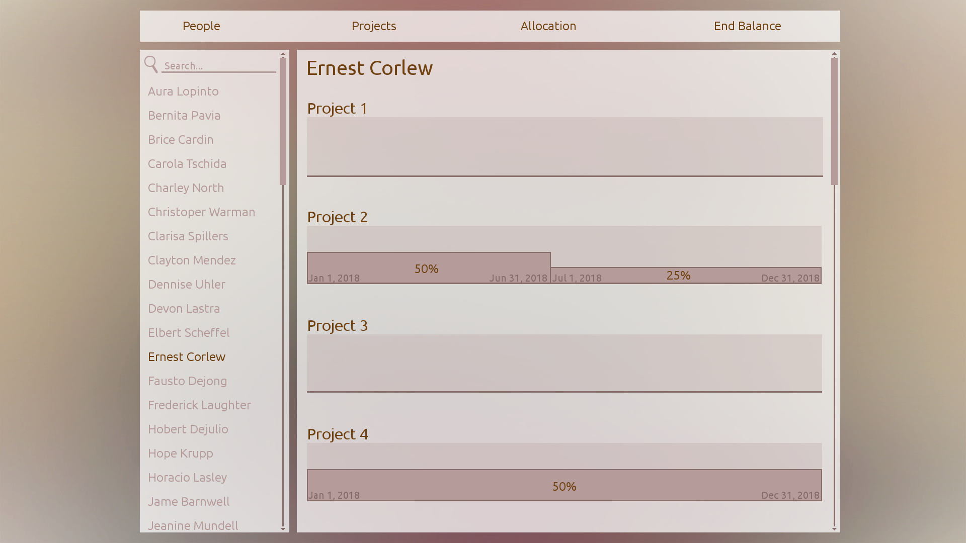
Initial backlog
Must be able to add a person in the persons tab
Must be able to edit a person in the persons tab
Must be able to remove a person in the persons tab
Must be able to add a project in the projects tab
Must be able to edit a project in the projects tab
Must be able to remove a project in the projects tab
Must be able to search for a user in the persons list
Must be able to select a person from a list of persons to display that’s person’s allocation view

Slide 7
Initial backlog
The allocation view must contain some calendar or timeline in the background for the individual projects
Must be able to double click on a person’s allocation view to initially allocate some amount of time
Must be able to click and drag the allocation horizontally to allocate time
Must be able to click and drag the allocation vertically to allocate the employment rate
Must be able to break an existing allocation to specify different employment rates for different time periods
The allocations view should be zoomable to facilitate the allocations and overview for a specific project
The allocations should be snapped automatically to end of each month

Slide 8
Initial backlog
The allocation view must contain all the projects that the user is currently working on
The allocation view should only contain projects with active allocations
The system must ensure that a system user can’t allocate time that exceeds the projects end date
The system must ensure that a system user can’t allocate an employment rate that exceed full time
The system should be able to generate a report over a person’s allocations that a system user can save in a certain file format
The allocation view must contain a total timeline that displays the summation of all the separate allocations
A view over a specific project that displays all the persons and their allocations would be a nice feature to have

Slide 9
Non-functional requirements
Adaptability and reusability (The client may want to integrate our front-end with their own back-end)
Usability (The main part of the project is the allocation view)

Slide 10
Roles and Responsibilities
Erika | Project manager | Frontend, client contact, Trello.
Christoffer | Developer | Frontend, GitHub, time report.
Filip | Developer | Frontend, presentation slides.
Sai | Developer | Frontend
Zaid | Developer | Backend, documentation creator.
Osamah | Developer | Backend, documentation creator.
Mohammed | Developer | Backend, validation and verification.
Matko | Developer | Backend, taking notes in meetings.

Slide 11
How we organize the work
Meeting every Monday discussing past week and planning upcoming week
Also client meeting every Monday to synchronize with they as well
Between meetings we use our Trello-board and makes sure it is up to date
For everyday contact we uses Facebook Messenger
Time report via excel file

